Slide 1
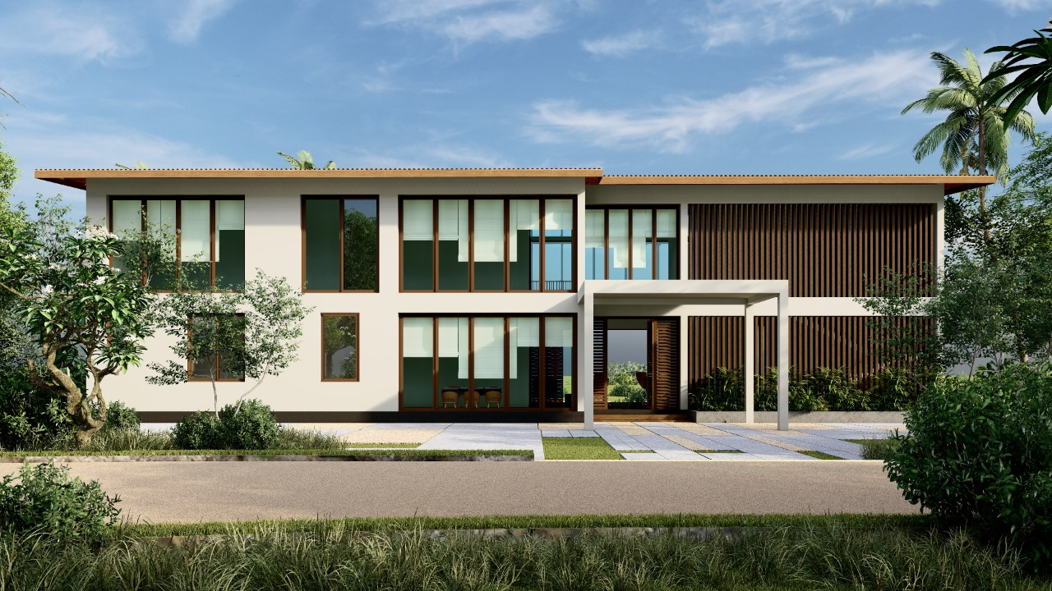

Rector Chalet Building
BUILDING CONSTRUCTION PROJECT REPORT PRESENTATION
GROUP-07

Slide 2
Team members
Name | Index Number
MAVKT Muramudali | D/BIT/22/0020
DAMS Priyakantha | D/BIT/22/0018
PKP Radeeshan | D/BIS/22/0009
UE Singhapura | D/BIT/22/0016
DNM Samarasingha | D/BIS/22/0006
CR Hapuarchchi | D/BIT/22/0019
WAKD Gunasekara | D/BIT/22/0021
RAKS Lakshani | D/BIT/22/0027
NMUI Gunasingha | D/BIT/22/0047
AMDC Adikaari | D/BIS/22/0026

Slide 3
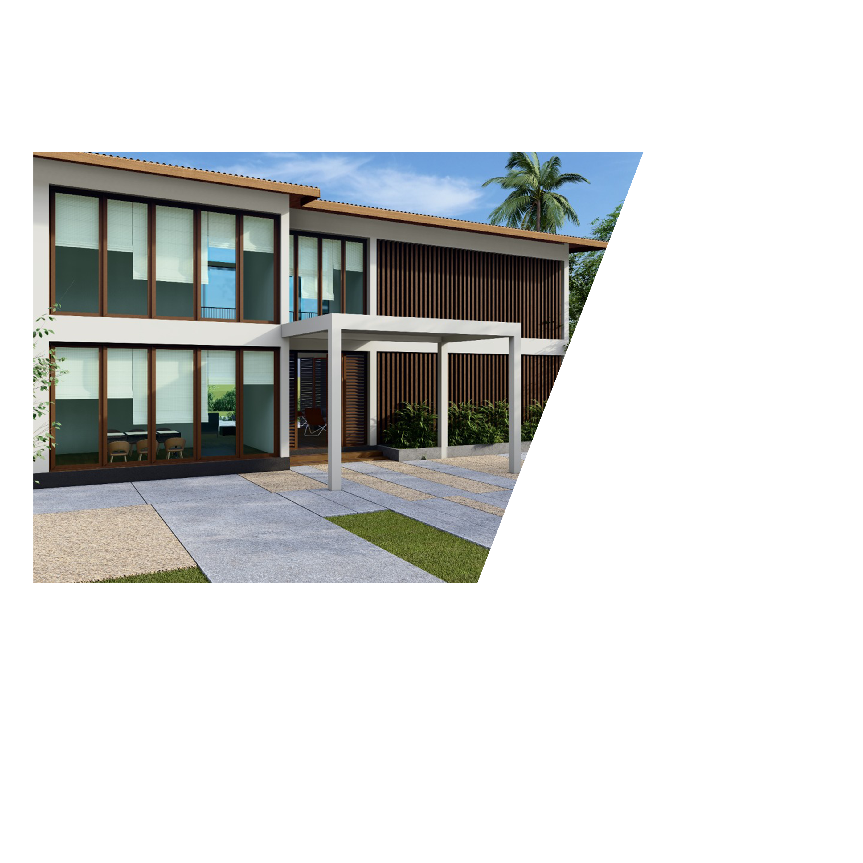

CONTENT
Introduction
Methods of collecting information
Analysis of data and presentation
Findings
Problem encounter
Suggestions and solutions
references

Slide 4
Introduction
The "Rector Chalet Building at KDU Southern Campus" project is a
significant endeavor situated in Sooriyawewa, Sri Lanka.
The primary goal of this project is to construct a fully furnished
chalet that will serve as the official residence for the Rector of the
Southern Campus of the General Sir John Kotelawala Defense
University (KDU).
The chalet will not only function as a residence but also
symbolize the university's dedication to its leadership and the
overall development of the campus.

Slide 5
Methods of data collecting
Project Focus: We're working on a project report for a construction project.
Data Gathering Methods: We've used collaborative interviews, discussions, and site meetings with stakeholders, architects, and contractors.

Slide 6
Analysis of data and presentation

Slide 7
Project plan and execution
Richard Branson

Slide 8
Budget and cost
Project Start Date: 14th March 2022
Initial Estimated Cost: Rs. 30.00 Million
Total Funds Allocated: Rs. 20.00 Million
Revised Estimated Cost (12th June 2022): Rs. 80.00 Million
Actual Date of End: 31st May 2023
Cumulative Costs at the End:
Material Cost: Rs. 79,409,947.37
Labor Cost: Rs. 15,946,350.00

Slide 9
stakeholders
KDU University: Initiator of the project and end-user of the chalet.
Rector of the Southern Campus: Occupant of the chalet.
Sri Lanka Navy Project Office: Responsible for the chalet's construction.
Construction Workers and Contractors: Executing the building work.
Local Government and Regulatory Bodies: Ensure project compliance with laws.
Material Suppliers: Provide essential construction materials.
Environmental Agencies: Monitor and care for the project's impact on the environment.
Local Community: May be affected and have input on the project.
Architects and Designers: Responsible for chalet aesthetics and functionality.
Quality Assurance Personnel: Ensure adherence to standards and regulations.
Project Management Team: Oversees project planning, budget, and schedule.
Government Oversight Groups: Monitor the project, if necessary.
Funding Organizations: Provide financial support if not funded by the university.

Slide 10
Risk management
Financial Risk
Compliance and Regulatory Risks
Design and Scope Risk
Risks in Construction
Environmental Dangers
Purchasing Chain Risks
Regulatory Risks
Communicating Dangers
Risks to Health and Safety
Risks to Stakeholders

Slide 11
Knowledge area

Slide 12
Problems encountered by during the project
Budget Overruns.
Adverse weather conditions.
Scope Changes.
Inadequate Cost Management.
Inaccurate Cost Estimation.
Financial Issues

Slide 13
Suggestions and solution
Track costs, manage change orders, allocate contingency funds, and maintain open communication for effective financial management.
Monitor scope changes, assess financial impact, and maintain transparent communication with clients and stakeholders.
Be ready to adjust the plan and budget as needed.
Ensure timely payments to subcontractors and suppliers to maintain smooth operations in the project's supply chain
Ensure the contingency fund sufficiently covers risks and adjust it as required through regular reviews.
Manage risks and adjust budgets proactively

Slide 14
summary

Slide 15
THANK YOU

